Slide 1
Recognition Of Driver behavior using Smartphone
Akram- HamidReza

Slide 2
What we have in this Project
Introduction
Block Diagram Of system
Data collection
Analysis of Data
App for Real time analysis

Slide 3
Driving behavior
Aggressive Driving
Typical Driving
Driver aggression can be determined by the number of potentially aggressive
events over a period of driving time ( in our projects we used 2 minutes).
The system can provide audible feedback if a driver’s style becomes aggressive
Movement
Turn, lane change, U-Turn, Braking, Speed

Slide 4
Data is processed every 2 minutes
Driving Movement
Acceleration pattern
Turn Right, Left
U-Turn
Lane change
Braking
1- # of fast turn
2-# of normal turn
3- Direction
4- time, Date
1- # of aggressive U-turn
2- # of normal U-turn
3- Direction(left, right)
4- time, Date
1- # of lane change
2- pattern(goes and back)
3- time, Date
1- # of Suddenly Braking
2- # of Normally Braking
3- time, Date
?
Scoring System
Report
Safety Alarm
Driving behavior

Slide 5
Data Collection
Totally 20 Data files were collected each including different possible movement patterns
We used AndroSensor App to get our data including :
The data from all device's sensors in real time
- accelerometer readings, (incl. linear acceleration and gravity sensors) - gyroscope readings, - light sensor value, - ambient magnetic field values, - device orientation - proximity sensor readings

Slide 6
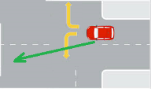
Analysis Of Data
Juggling Priorities
Detection of Movements
Juggling Priorities
Detection Cues
U-turn
Turn
Braking
Lane change
In this part we need
To visualized data to
see which components
of our sensory data
are most representative
for each particular movement
Which one to detect first

Slide 7
Achievements
The gyroscope signals are a clearer indication of vehicle turn movement
Based on our position of smartphone during data collection, Gyroscope signal along Z axis represents vehicle turn
For turn also we can use Acceleration along x axis
Acceleration along Y, is most descriptive of forward movement
Turn left
Turn right

Slide 8
How to detect Turn Left And Right

Slide 9
Turn Right Pattern

Slide 10
Fast Turn Right

Slide 11
What method to use for detecting Left-Right Turn
If we didn’t have any other movement, it was ok to use Threshold, but since we have other movements like lane- change which is very confusing with turn left and right, so I use the following approach which works perfect:
1- take integrate of the data (120)
2- take difference of integrals every 100 samples(4 second)
3- Set the threshold value ( Here abs(7))

Slide 12
Integral result
Threshold =Abs( 7)

Slide 13
How to Detect Turn Left-right is normal or aggressive
The previous procedure can’t detect that the turn right or left is aggressive or not. Only can find the existence and direction of turn.
So we use the following method to find the aggressive or normal turns
We pick the samples in original Gyro_z corresponding the 100 samples that turn happens(Turn Detection)
We take window averaging of 7 samples to remove very high noises
we set a threshold for it by analyzing the previous data

Slide 14
Aggressive Turn VS. Normal
Threshold>.5 aggressive
Otherwise Normal

Slide 15
Braking Detection
Apply a filter to remove high frequencies in Acceleration in y direction which shows forward movement, for this I use window averaging with window size of 31 samples (Average 31 – dc( total average)) :X
Find Mins in filtered data X:
If Min <-1 normal braking , if min<-2 aggressive braking

Slide 16
Aggressive-Braking Vs. Normal Braking

Slide 17
Aggressive-Braking Vs. Normal Braking

Slide 18
Lane Change
We chose Gyro_z and do the following processes:
First take integral of the data
High pass filter (Average window size of 7 ): X
High pass filter ( X- Average window size of 150): Y
detect Pick to know when the event happens
Many picks will be detected which are not all lane change indicators, in order to find picks related to lane change we do the following process:
1-Find the biggest picks
2-Delete 1 adjacent pick on both side of the biggest
3- go back to step 1 and repeat it until the picks <Threshold
Threshold>.35

Slide 19
original signal

Slide 20
High pass filter and Integral

Slide 21
Lane Change pick detection Process

Slide 22
U-Turn detection algorithm
Take Integral of Gyro_z( total sum of turn degree)=Θ
Take difference of integral output in every 120 samples(10 second) :ΔΘ
If ΔΘ> 60 this movement is U-Turn, otherwise is not U-turn. Happen in samples[s1-s2]
In Accelerometer on x-direction :
Remove high frequency noise using averaging in windows of 7 data : X
Look for roots on both sides of s1-s2 : W
If W>115 normal w<115 aggressive U-turn

Slide 23
Aggressive VS. Normal U-Turn

Slide 24
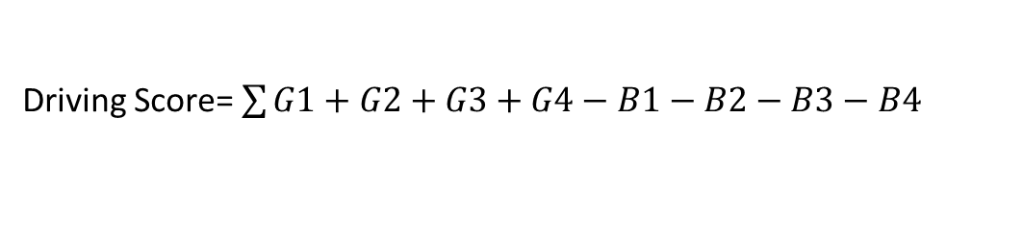
Scoring System
Bad Driving Behavior
Good Driving Behavior
Fast Turn (-B1) Normal Turn (G1)
Fast U-turn (-B2) Normal U-Turn (G2)
Bad Pattern Lane Change(-B3) Lane change Normal(G3)
Suddenly Braking(B4) Normal Braking(G4)
Driving Score= $\sum{G1+G2+G3+G4−B1−B2−B3−B4}$
If Driving Score > TG so normal Driving
If Driving Score <TB So warning for Bad Driving Trend

